Slide 1


Techno Power Engineers
Expanding Possibilities
Company Profile
B/21 Aloknagri,1305 Kasba Peth, Pune 411011
www.techno-power.in

Slide 2

Techno Power Engineers
Expanding Possibilities
Govt. Licensed
Electrical Contractor
www.techno-power.in

Slide 3

History
Techno Power Engineers
  All are known about Unique Engineers since 2004, in PROJECTS, SERVICES & AMC’S. Over the years, Unique Engineers earned reputation for Excellence, Quality & Quick response. To keep bound with today’s fast growing, innovative business climate for providing better services to our valuable clients, we are overcome with new firm as Techno Power Engineers.
www.techno-power.in

Slide 4
Introduction
Techno Power Engineers
It gives us immense pleasure to introduce ourselves as a team of professionals with a shared vision. We undertake several turnkey projects which include Consulting & Contracting of Commissioning & Installation of LT and Electrification jobs in Commercial & Industrial Projects, Hospitals, Schools, Colleges, Software Companies, IT Projects and Five Star Hotels etc.
Our eye for quality and our dedication to the delivery of top-notch customer service are what make us the electrical company of choice for several areas in India.
Whether you require industrial & commercial electrical work, Techno Power Engineers is fully committed to professional and affordable electrical services. We carry out all aspects of electrical work, from design and consultation through to commissioning for clients in the industrial & commercial sectors.
www.techno-power.in

Slide 5

Techno Power Engineers
Dear Sir/Madam
It’s an esteemed pleasure to introduce ourselves as a platform for new ideas, bigger challenges & trouble-shooters of all your problems with highly human friendly solutions.
We at “Techno Power Engineers” make things possible by focusing on the two main pillars of the business that is “Time & Quality.” For us time is money & Quality is the trust. Your success and satisfaction is the prime motto, which we achieve by delivering quality services within time.
Under the guidance of our technical and project head, “Techno Power Engineers” plan to continue its heritage of leadership in the market with the community where we work. His vast experience of 15+ years, not only in Project Management, Procurement, Project Executions & Manpower Handling, but also in Accounts & Control of projects in Industrial, Commercial, Techno Commercials & IT Sector. we are flourishing the companies, we are serving to.
We as Techno Power Engineers assure to you as our valuable clients that our commitment with you of quality services, providing BEST WORK within time limit, will remain be the fundamental element of our companies success.
We will feel encouraged to work with you if you provide us the opportunity to serve you.
.
www.techno-power.in

Slide 6

Core values
Techno Power Engineers
The techno power engineers will conduct all activities upon the basis of these core values. All employees commit to this values as essential characteristics of good business & professional conduct.
Loyalty
Customer satisfaction
Commitment
Excellence
Integrity
Teamwork
Quality
These values are the foundation of the Techno Power Engineers
www.techno-power.in

Slide 7
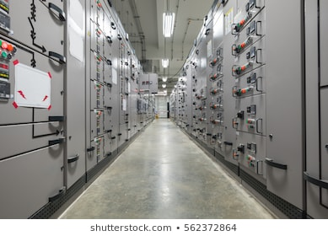
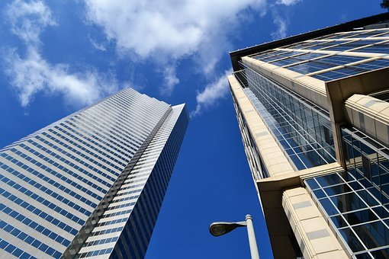

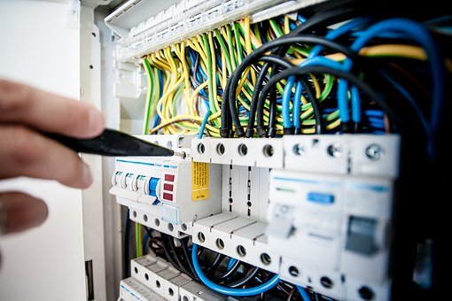
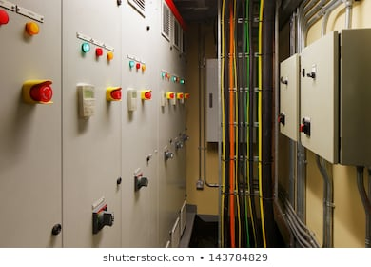
We are licensed Electrical Contractor & Engineers
Techno Power Engineers
Turnkey projects:-
Industrial
Commercial
with HT & LT Electrification solutions.
www.techno-power.in

Slide 8
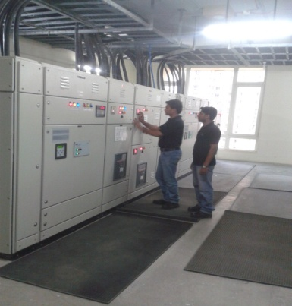



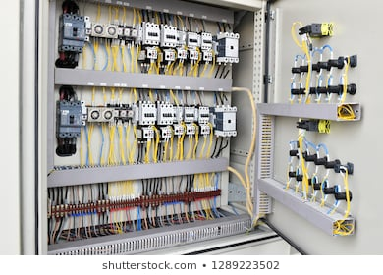
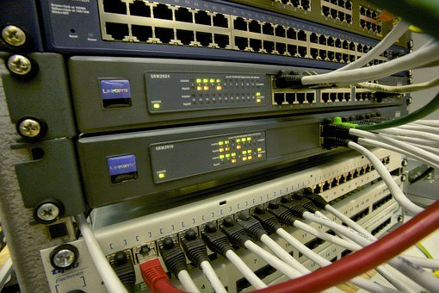
Product and Services
Techno Power Engineers
Electrical Project & Maintenance.
Projects in IT
Commercial sectors
Industrial sectors
Automobile Industries
AMC’s for :
Electrical System
Networking
Fire Alarm System.
PA System
Computer Software & Maintenance.
Pre-Post Thermography
Earth-pit Testing
Energy Meters & Measuring Instruments Calibration
Controls & Automation
Fire & Security system
C.C.T.V. & access control systems
Energy Audit & EMS Consultancy.
Facility Management services
Manpower provision
www.techno-power.in

Slide 9

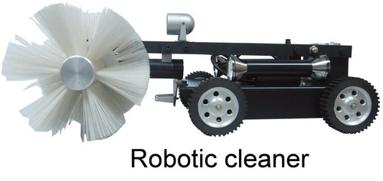
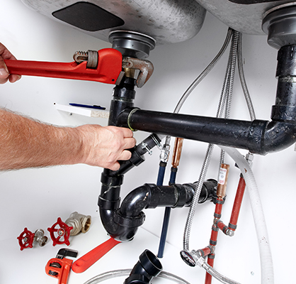



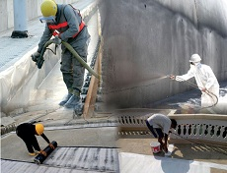
Other Services
We also provides below services:-
Civil Work
Robotic Duct Cleaning
Plumbing work
Painting Work
Fabrication Work
Carpenter work
Waterproofing
www.techno-power.in

Slide 10

Trading Division
The profile of Techno Power Engineers fits into every other needs of Electrical Engineering activity.
Projects Division
The Projects Division, handles project works such as, Supply, Erection, Testing, Commissioning of HT & LT. Deals in HT & LT Panels, Complete Electrification, LT/HT Cabling works, Installation of DG sets, Networking, and Installation of Fire Alarm System, control & Automation System, CCTV System and Access Control System.
Facility Management Division
This Division operates & maintains complete Electrical System for Software Development Companies, IT Parks, Banks, Industries, Hospitals and high-rise buildings.
At Techno Power Engineers one can find a Solutions to almost all Electrical related requirements. To state specifically, Techno Power Engineers attends to the client's needs in Cables, cable trays, earth electrode, Switch Gears, Sensors, Surge Suppressors, Interfacing & Interconnect Products, and all allied material required for Electrical/Plumbing/Carpentry/ CCTV/FAS/Networking setup and other sectors also.
Control Panel Manufacturing also forms part of this Division. This Panel range includes Power Control Centers, Motor Control Centers, Lightning Distribution Boards, Capacitor Panels & Auto Main Failure Panels.
The FM division also does periodic and shutdown maintenance on turnkey basis. This division also helps the clients, in proper taking over of assets and is very proficient in highlighting of deficiencies and deviations.

Slide 11
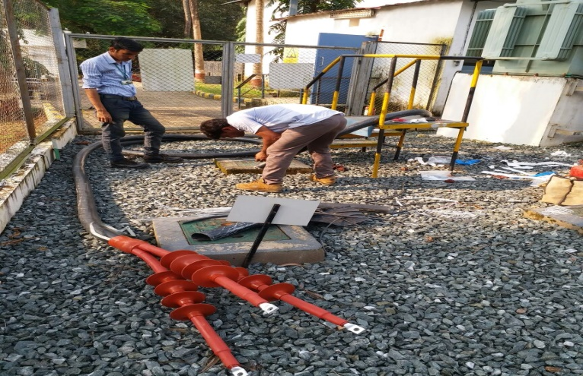
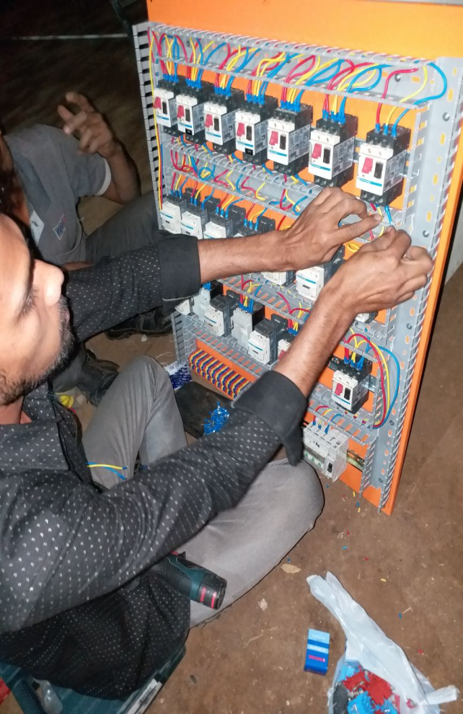
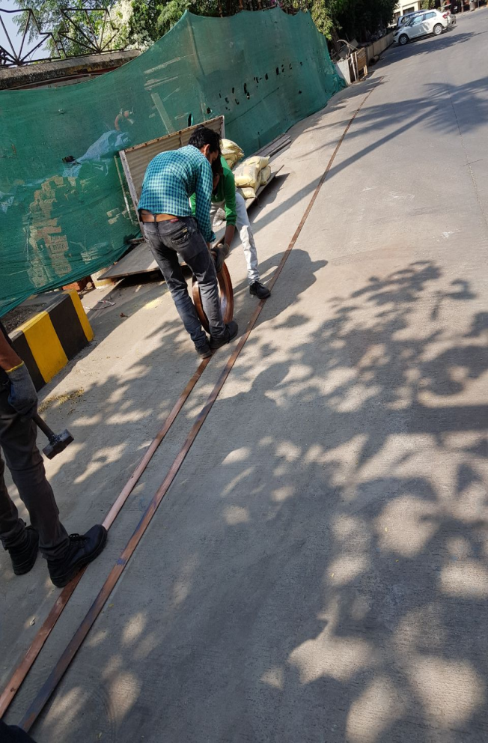
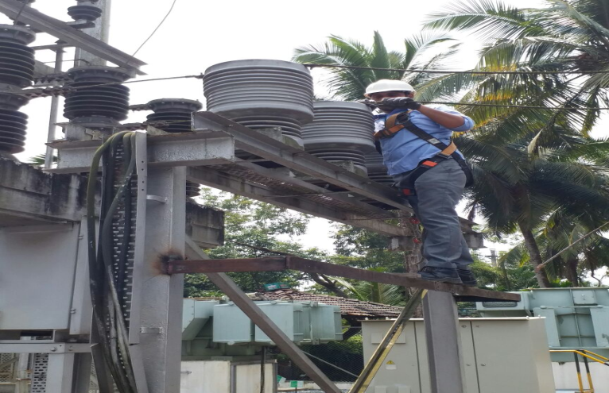
QUALITY OF WORK AND SERVICE
Techno Power Engineers
www.techno-power.in

Slide 12
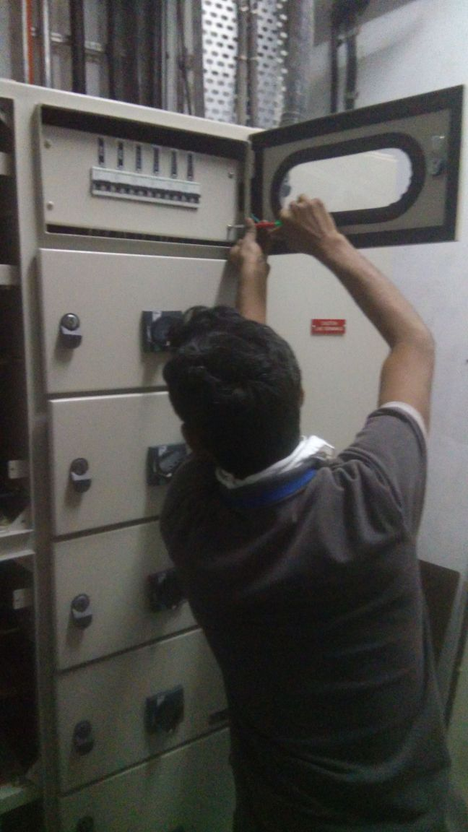
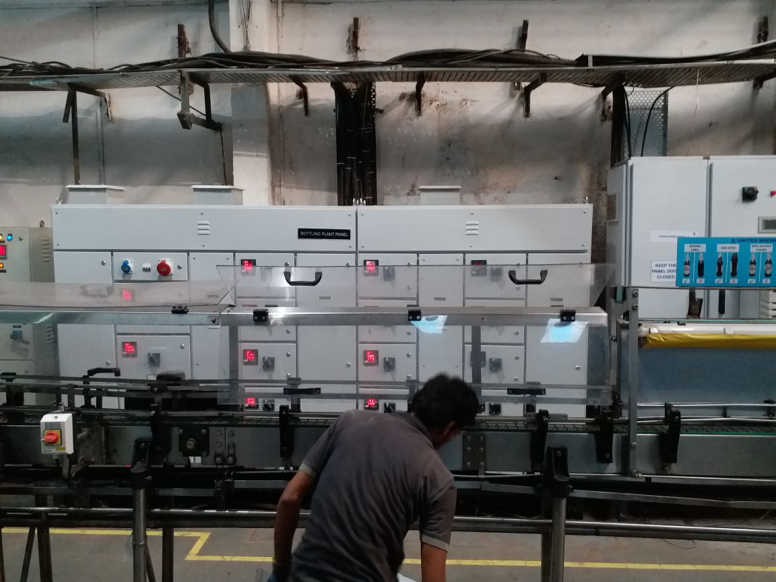
ELECTRICAL PROJECTS
Techno Power Engineers
www.techno-power.in

Slide 13
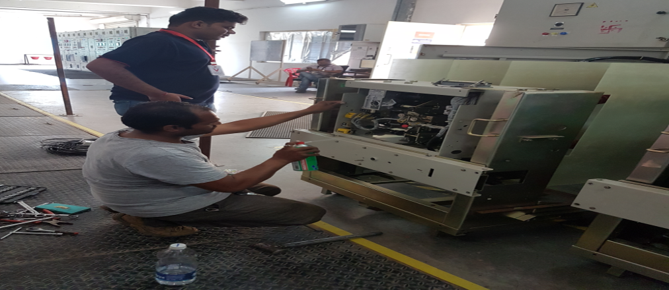
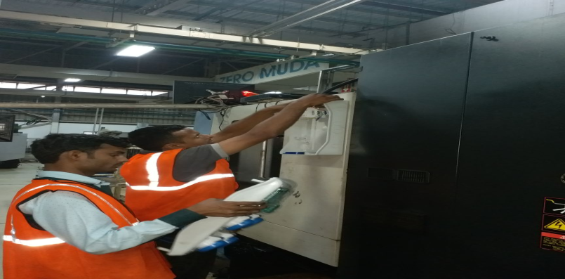
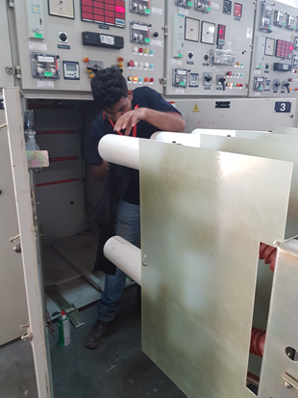
ELECTRICAL MAINTENANCE
Techno Power Engineers
www.techno-power.in

Slide 14
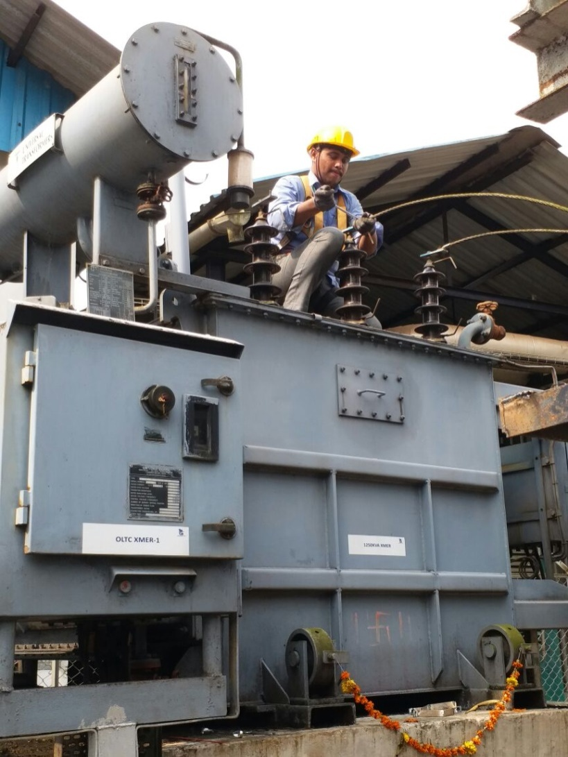
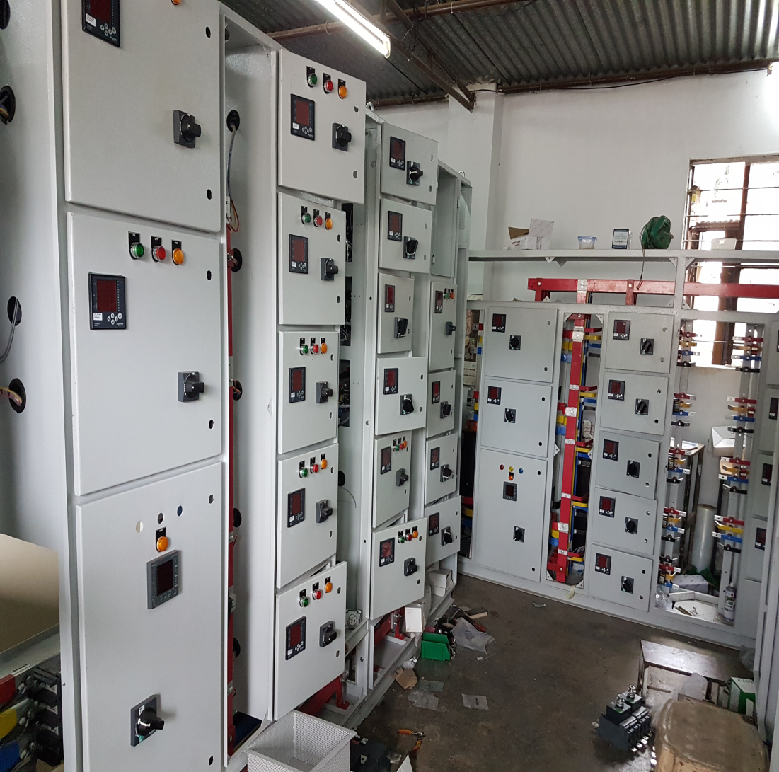
Techno Power Engineers
www.techno-power.in

Slide 15
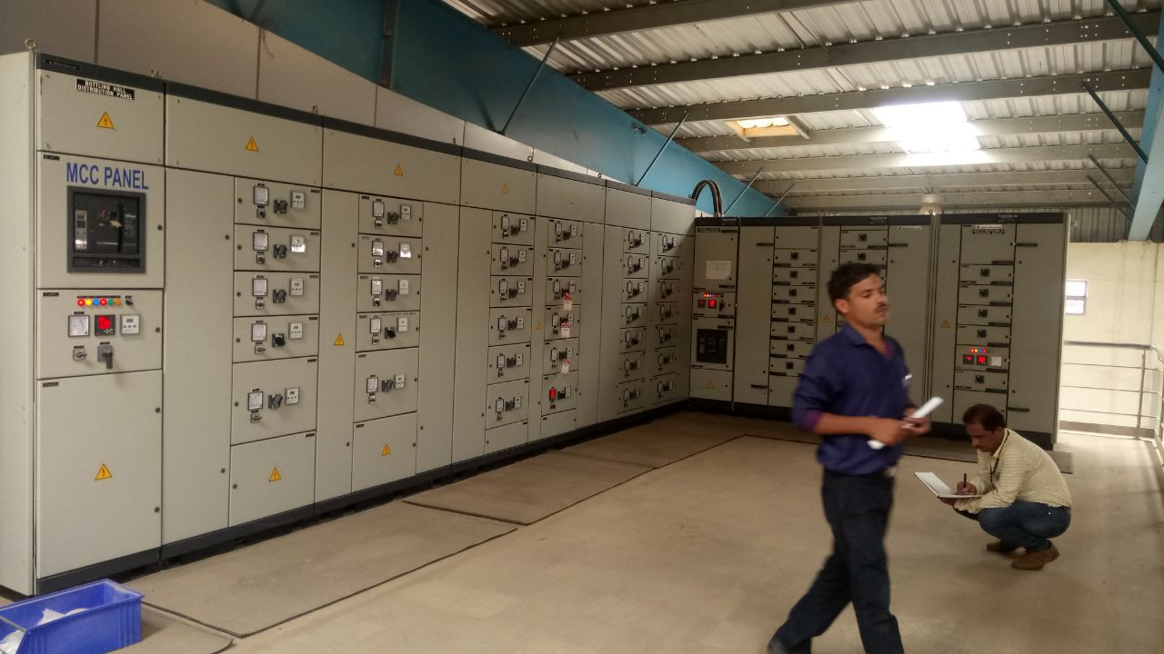
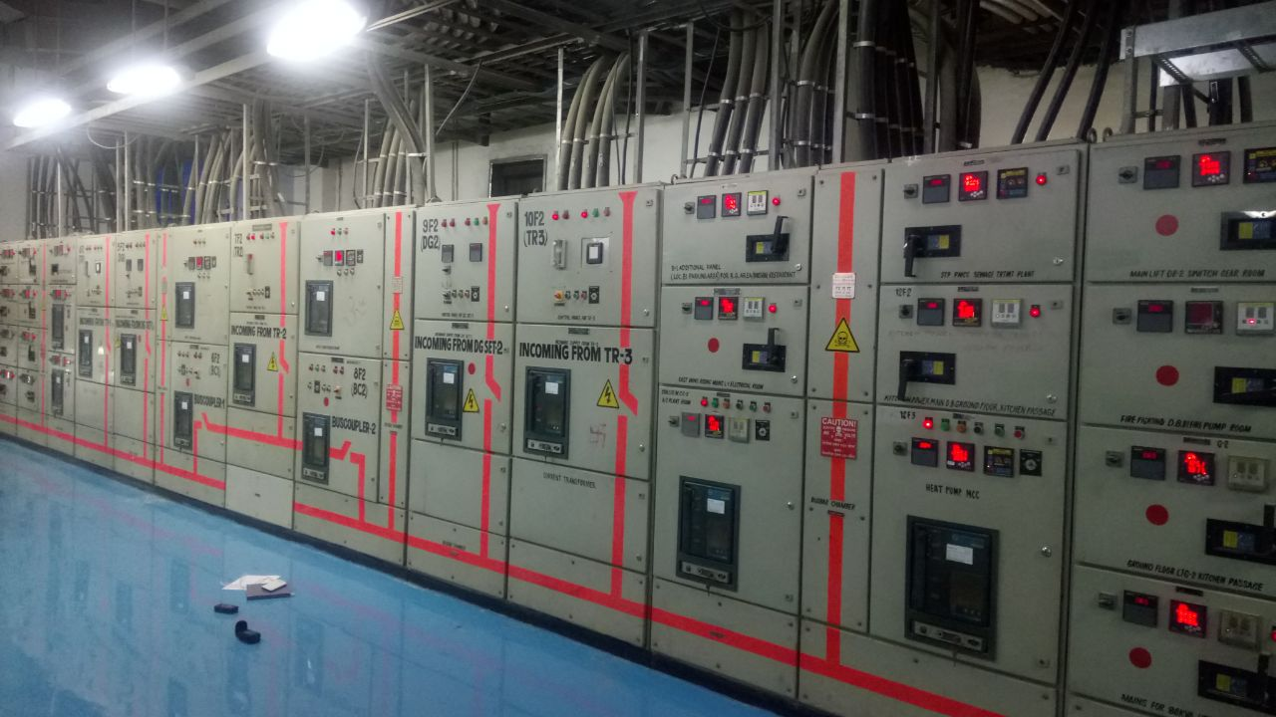
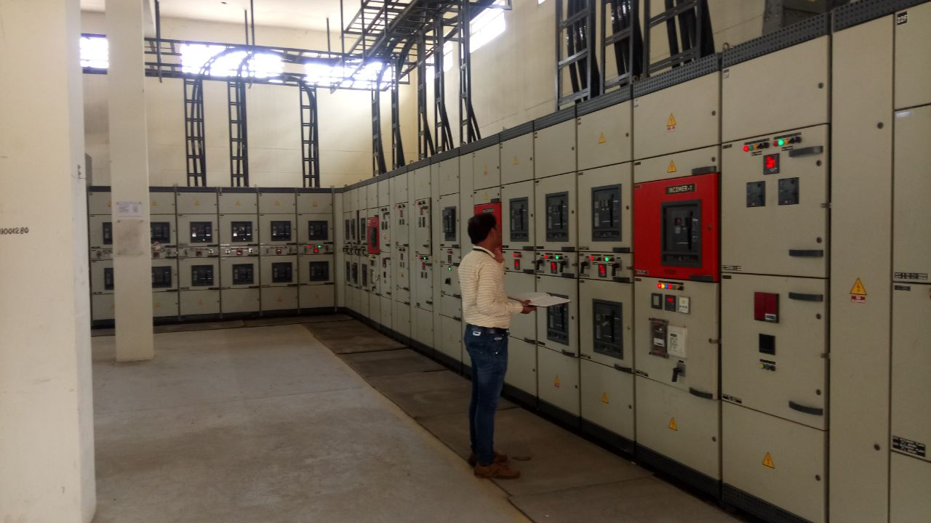
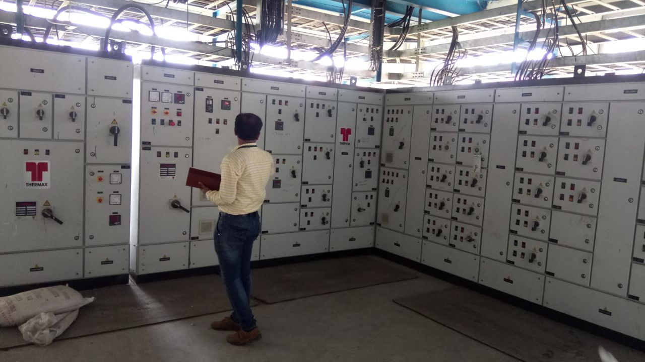
UNITED BREWERIES LIMITED, PATNA
Techno Power Engineers
www.techno-power.in

Slide 16
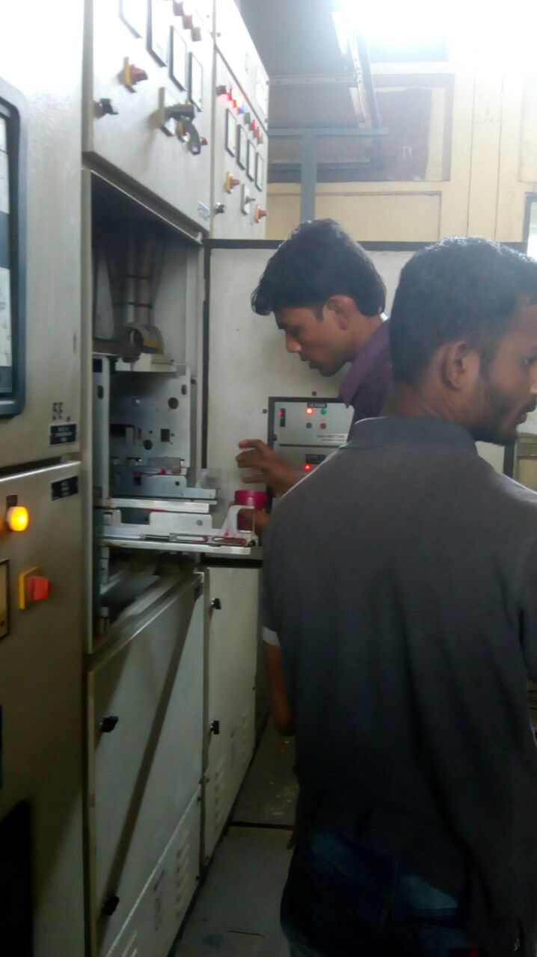
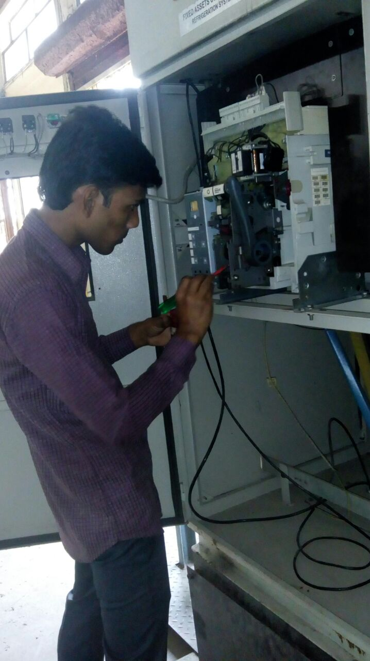
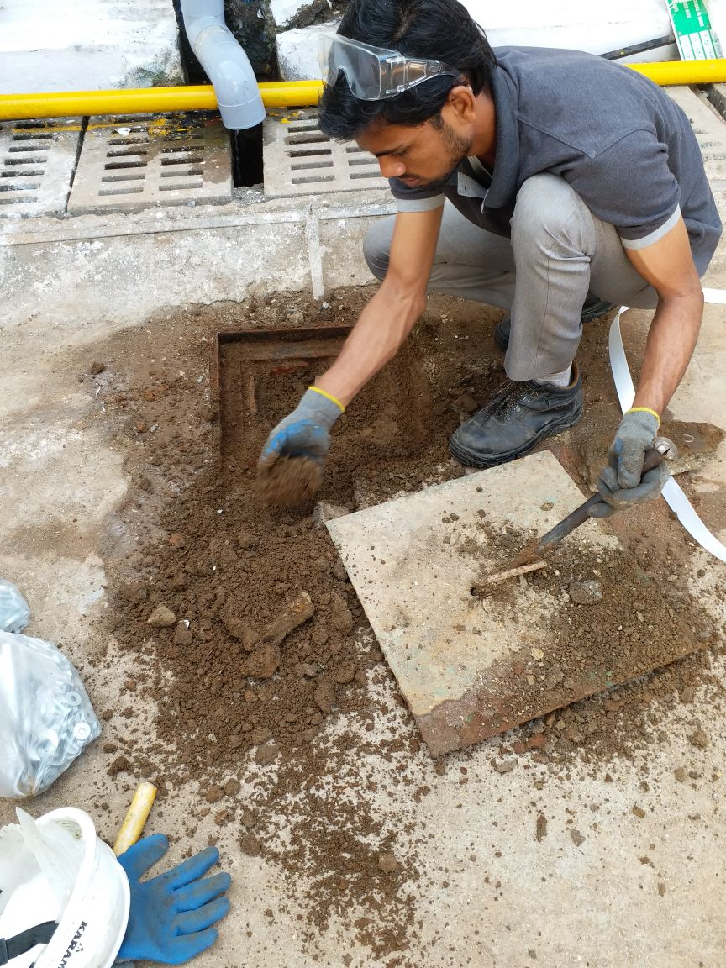
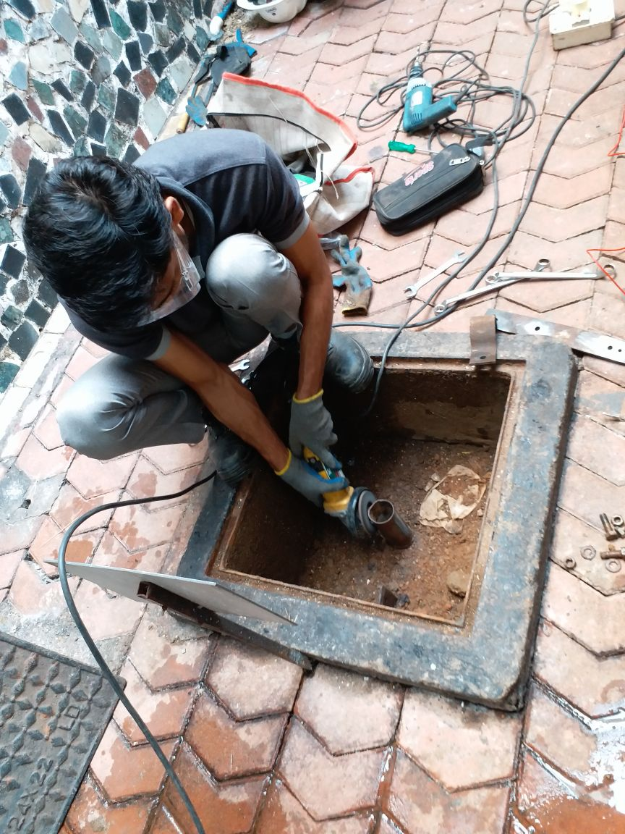
Techno Power Engineers
UNITED BREWERIES LTD, TALOJA
www.techno-power.in

Slide 17
MAJOR PROJECTS
Techno Power Engineers
1. United Breweries, Goa
CAN line installation, Commissioning and expansion, Also we added 1250 KVA transformer with protection of VCB and allied switchgear and required LT panel and stabilizer and Automation Panel and MCCB panel.
2. Hotel Preeti Executive
Designing, Consulting and Contracting(Received an award for the work from Mr. Sharad Pawar)
3. United Breweries, Taloja
Thermography Solution
4. Wipro Limited
Transformer Oil Filtration
Fire engine servicing
Earth pit testing
www.techno-power.in

Slide 18
Techno Power Engineers
5.Deluxe Entertainment India Pvt Ltd
i. AHF panel
ii. Harmonic study
iii. Thermography
6. 3M India Pvt Ltd
HT and LT Maintenance
7. Royal Western Turf Club, Mumbai
APFCR Panel
Transformer Oil Filtration
8. Aditya Birla Group
APFCR panels.
9. IT industry projects and expansion work in WIPRO, SYMANTEC, SUNGARD, AMDOCS, MAXXTON, FIS, DG CAPTION, CREDIT SUISSE.
10. FAS, CCTV AND ELECTRICAL AMC PROJECTS IN ALL IT AND COMMERCIAL SECTORS.
www.techno-power.in

Slide 19
Techno Power Engineers
Our Clientele
Sr.no. | Client Name | Contact Person | Contact Number
1 | Wipro Limited, Pune | Mr. Dayal Khare | 9730066495
2 | Opus Solutions Pvt. Ltd, Pune | Mr. Sushant Urankar | 9326433007
3 | Tata Communications Limited | Mr. Sagar Zolekar | 8793362323
4 | Atos | Syntel International Pvt. Ltd. | Mr. Keshav Kulthe | 7875786559
5 | State Street Syntel Services Pvt. Ltd. | Mr. Sirajuddin | 7767020021
6 | Nxtra Data Limited | Mr. Amol Jadhav | 9860011113
7 | Loreal India Pvt. Ltd. | Mr. Mahesh Ukirde | 8805988015
8 | Herman Connected Services Corporation (I) Pvt. Ltd. | Mr. Vishal Kharde | 7774922870
9 | FEV India Pvt. Ltd. | Mr. Adil Hussain | 9049991914
10 | Ognibene (I) Pvt. Ltd. | Mr. Maruti Pratap Hegde | 8390176486
11 | Maxxton Technology (I) Pvt. Ltd. | Mr. Jay Bhavsar | 9881549509
12 | Yardi Software (I) Pvt. Ltd. | Mr. Vadiraj Gokak | 9881904352
13 | Credit Suisse, Pune | Mr. Siddharth Ambekar | 9503396824
14 | CBRE, Pune | Mr. Inamdar | 9850029058
15 | 3M India Limited, Ranjangaon | Mr. Vinod Rathod | 9960294572
www.techno-power.in

Slide 20
Techno Power Engineers
16 | Nucleus Mall, Pune | Mr. Vinod Pillay | 9923197910
17 | Delux Entertainment | Mr. Krushna | 9834659081
18 | Black pool Realities | Mr. Jerry Fernandes | 8149881259
19 | DB Xento Systems Pvt. Ltd. | Miss. Sunita Mane | 7774034349
20 | Keimm Designs | Mr. Shahdab Mulla | 9049052780
21 | Compass (I) Support Services Pvt. Ltd | Mr. Balkrushna Berad | 8408886205
22 | Crest Software, Magarpatta City, Pune | Mr. Prem | 8446551632
23 | FIS, Pune | Mr. Anil Bhalerao | 9960670298
24 | RMZ Corp | Mr. Mangesh Gaikwad | 9665777345
25 | United Breweries, Goa | Mr. C. Rajshekhar | 9008999334
26 | United Breweries, Mangalore | Mr. Dilesh Pillay | 7019267679
27 | United Breweries, Taloja | Mr. Chand Basha | 9820698566
28 | United Breweries, Golconda | Mr. Himanshu | 9765390154
29 | United Breweries, Patna | Mr . Sattyendra | 7414008444
30 | United Breweries, Orissa | Mr. Mr. Avijit banik | 9238009010
www.techno-power.in

Slide 21
Techno Power Engineers
31 | Venky's | Mr. Chandrashekhar Mahajan | 9371026821
32 | Honeywell | Mr. Bhosle | 9921495051
33 | White Cooper Gastronomy | Mr. Ashish Mehta | 9922935591
34 | Zensar | Miss. Aarti Mankar | 8806247880
35 | Hotel Preeti Executive , Satara | Mr.Deshmukh | 9766699977
36 | EFS Facilities Services | Miss. Nisha Ghorpade | 9370640408
37 | Design Studio | Mr. Rahul Dhulap | 9823023735
38 | R.W.I.T.C Ltd, Race Course | Mr. Chetan Patil | 9819723292
39 | Columbia Asia Hospitals | Mr. Sameer desai | 7798988917
40 | Inorbit Mall , Pune | Mr. Nadeem Saith | 9762000303
41 | Inox Multiplex | Mr.Babu ashtul | 9673012828
42 | schneider Electric Ltd, Pune | Mr. Aatish Mudholkar | 9881100961
43 | Siemens Ltd. SBT Division, Pune | Mr. Pathan | 9822290939
44 | Siemens (switchgear warehouse, Bhivandi) | Mr. Santosh Shete | 9503051074
45 | Symantec Software (I) Pvt. Ltd | Mr. Firoj Tamboli | 985081869
46 | Emerson Network Power (I) Pvt. Ltd | Mr. Vijay Kulkarni | 9850828277
47 | Phonex Marketing city, Pune | Mr. Lalit Mahajan | 8411015444
48 | Piaggio Vehicals Pvt. Ltd, Baramati | Mr.Promad jadhav | 9822522965
www.techno-power.in

Slide 22
Techno Power Engineers
49 | Orchid Five star Ecotel hotel, Balewadi | Mr. Deepak Gholap | 8422888160
50 | TCE Consulting Engineers, Pune | Mr. Abhijeet Vaidya | 020-25593739
51 | Rural Shore Business services Pvt. Ltd | Mr. Naval | 9617888865
52 | Heptavision Automation(I) Pvt. Ltd | Mr. Aakash | 9146028961
53 | Spear Logistic Pvt. Ltd | Mr. Ramchandra | 7507 777185
54 | Cloud9 Hospital |Kids Clinic (I) Pvt. Ltd | Mr. Venkat | 9130026980
55 | Shree Construction | Mr. Shrikant | 9527793600
56 | Siemens Information Technologies | Mrs.Shailaja Deshpande | 020-25809000
57 | India Infoline Ltd | Mr.Ashish Sirdeshpande | 9967035614
58 | Praxier Pvt Ltd, Pune, Mumbai | Mr. Santosh Balkunde | 9321520980
59 | Sakal Charity Trust | Mr. Vijay Doiphode | 9922419205
60 | Tyco Fire & Securities Pvt. Ltd | Mr. Patil | 9820420841
61 | Vasu Infosec Pvt. Ltd | Mr. Vivek Narang | 9371044049
62 | Kunhar Peripherals Pvt. Ltd. Pune | Mr. Ashok Kapadia | 9823023764
www.techno-power.in

Slide 23
Techno Power Engineers
63 | Lear Automotive | Mr. Santosh Modi | 9881245436
64 | Syndicate Bank Pune Branch | Mr Maharaj Sir | 9423585216
65 | Farefield Pressing Pvt. Ltd | Mr. Jagtap | 9822047147
66 | AN Associates(Architects & Interior Designers) | Mrs. Aruna Narayanan | 9822055633
67 | Ever Electronics(I) Pvt Ltd | Mr. Srikumar | 9850832274
68 | Moreal InfoTech Pvt. Ltd | Mr. Kishore Palan | 9850503565
69 | Yazata Estates & Promoters, Pune | Mr. Lazadpur Faridani | 9823080881
70 | First Future Software Pune | Mr. Satish Singh | 9860265567
71 | Sunbeam InfoTech Pvt. Ltd | Mr. Sanjay Choudhari | 9960265567
72 | K& P InfoTech | Mr. Vijay Barve | 9822190401
73 | Tech Associates Pune | Mr. Aditya Jaiswal | 9373312022
www.techno-power.in

Slide 24
Techno Power Engineers
74 | Kalyani InfoTech Pvt. Ltd | Mr. Anand Meshram | 9011012082
75 | Ethix Interior Pune | Mr. Rajesh Ranka | 9923587160
76 | Ryan Interiors(Architects & Interior Designers) | Mr. Histas Randeria | 9822288220
77 | E-Technologies & Services | Mr. C V Palsule | 9850054003
78 | Avaloq India Pvt. Ltd. | Mr. Aniket Savalikar | 9970581424
79 | Nax-Navbharat Archive Express Pvt. Ltd. | Mrs. Jyoti Choudhari | 9325305000
80 | Diebold System Pvt Ltd, Mumbai | Mr. Ilyas Bagwan | 9920775550
81 | Poona Interior Projects Pvt. Ltd | Mrs. Shridaa Raheja | 9922960600
www.techno-power.in

Slide 25













www.techno-power.in

Slide 26













www.techno-power.in

Slide 27






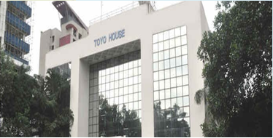

www.techno-power.in

Slide 28









www.techno-power.in

Slide 29
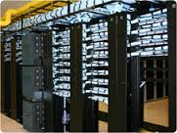
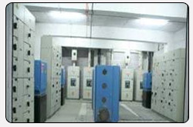
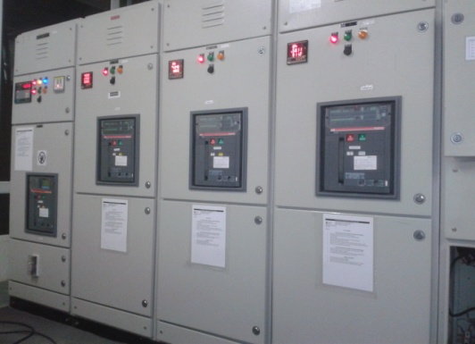
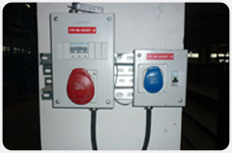

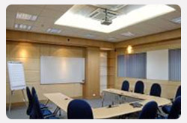
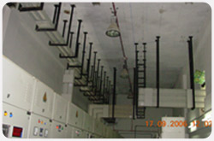
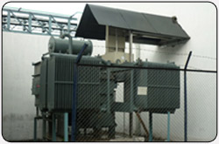
Techno Power Engineers
www.techno-power.in

Slide 30






CONTACT PERSONS
Techno Power Engineers
Mr. Aijaj Mulla
Miss. Akanksha Gowardhane
Project Head
Commercial Head
9326787064
9322499234
aijaj@techno-power.co.in
projects@techno-power.co.in
Head Office :
B/21 Aloknagri,1305,Kasba Peth, Pune 411011
www.techno-power.in

Slide 31

Techno Power Engineers
“ Nature is a brilliant engineer and builder. It knows how to create seashells that are twice as strong as the most resistant ceramics human beings can manufacture, and it produces silk fibers five times stronger than steel. Nature also knows how to create multipurpose forms.”
…..Neri Oxman
www.techno-power.in

Slide 32

Thank You
TECHNO POWER ENGINEERS
www.techno-power.in

